Slide 1
Web Programming Mini Project
<Title>
<Name>
<Reg. No.>
<Department>

Slide 2
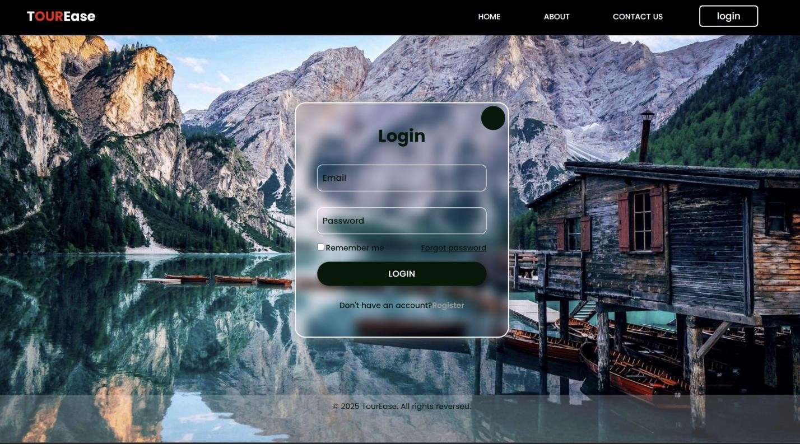
HOME PAGE
HTML AND CSS:
Global styling ensures consistency with * and improves readability with font-family:
'Poppins', sans-serif.
Background and layout use background-image: url(...) to set the background and display: flex; justify-content: center; align-items: center; to center elements.
Navigation menu remains and buttons are styled with border-radius: 3px; text- transform: uppercase.
Hover and animation effects are applied using transition: transform .5s ease; for
smooth interactions.

Slide 3
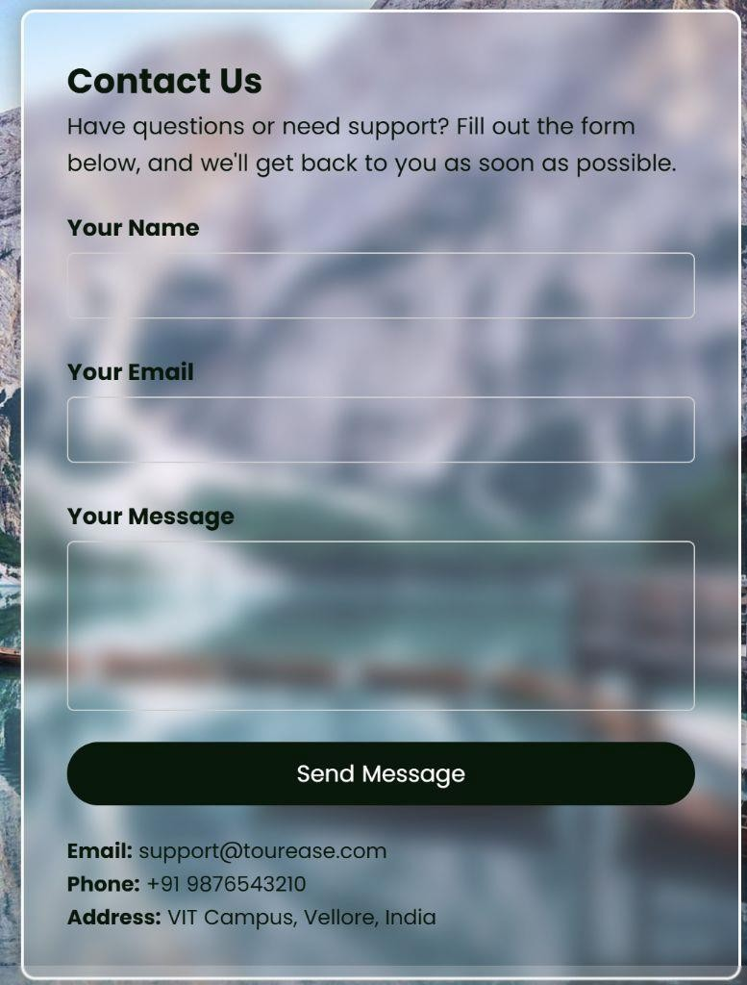
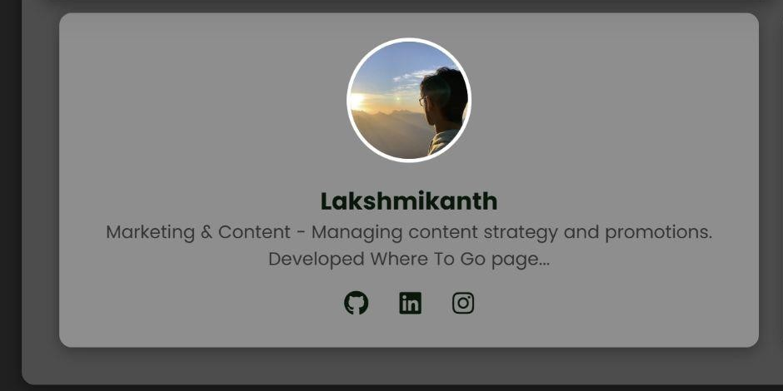
Responsive design is managed using @media(max-width:858px) { ... } to adapt layout
Buttons and effects include .btn:hover { transform: scale(1.1); } for interactivity and box-shadow: 3px 3px 10px rgba(0,0,0,0.5); for a 3d effect.
Contact section uses backdrop-filter: blur(8px); to create a glassmorphism effect and
.contact-form button:hover { background: linear-gradient(...); } to enhance buttons.
CONTACT US ABOUT US

Slide 4
JAVASCRIPT
LOGIN IN FORM
toggle for responsive navigation uses JavaScript to handle the hamburger menu (check_btn) for mobile users and toggles navigation visibility on click.
Popup login/register form is controlled by JavaScript using document.querySelector(".cover_box").classList.toggle("active-popup") to show or hide the popup.
Form transitions between login and register are handled using
document.querySelector(".cover_box").classList.toggle("active") for smooth switching.
Close button functionality is added with document.querySelector(".icon- close").addEventListener("click", function() {...}) to close the popup when clicked.
Login form validation checks if email and password fields are correctly filled before allowing submission.
CONTACT US SECTION
Contact section animation ensures the section appears smoothly after page load using setTimeout.
Checks for empty field using “trim()” and shows an alert message if not filled.
JavaScript dynamically adds or removes CSS classes to enable smooth UI effects like animations and transitions.
JavaScript enhances user interactivity by preventing default actions and improving form handling.

Slide 5
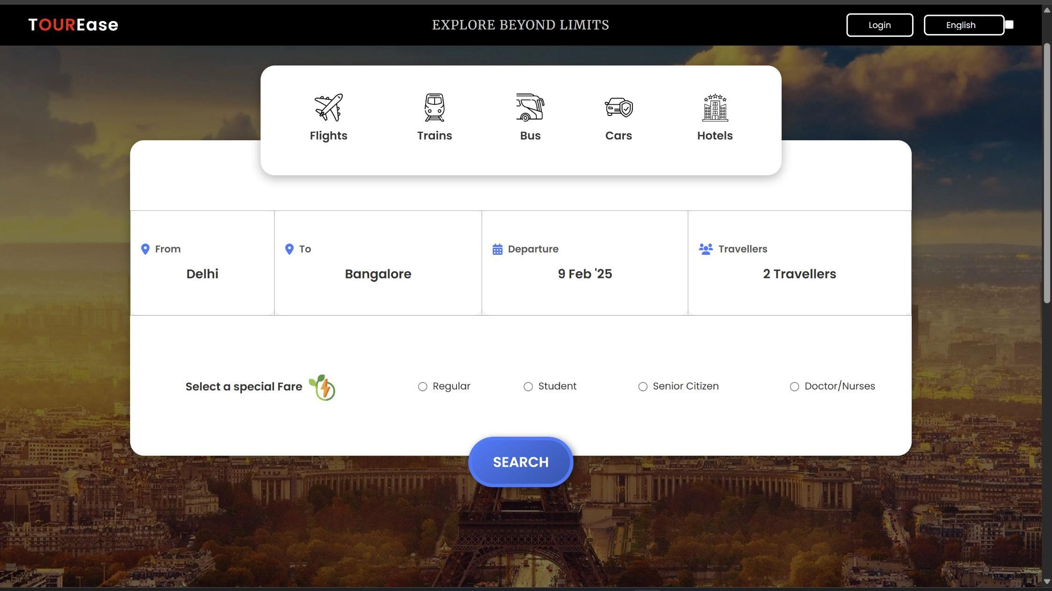
JAVASCRIPT
Input Field Toggle Functions
These functions show or hide input fields when clicked, making the interface clean and user-
friendly.
toggleSearch(id): Toggles visibility of city search bars for selecting "From" and "To" locations.
toggleDatePicker(id): Displays or hides the date picker for selecting a departure date.
toggleTravellerInput(id): Toggles the input box for selecting the number of travelers.

Slide 6
Formats and updates the departure date dynamically using:
document.getElementById('departureDate').addEventListener('change', function()
Traveler Count Selection:
Updates the number of travelers when changed.
4) Fare Selection Highlighting
Allows users to select a special fare type (e.g., Student, Senior Citizen) and highlights the selected option.
When a radio button is selected, the selected fare type is highlighted while others are
deselected.
5) Transport Mode Selection
Clicking on any travel option (Flights, Trains, Bus, etc.) highlights the selected mode, giving users clear visual feedback.

Slide 7
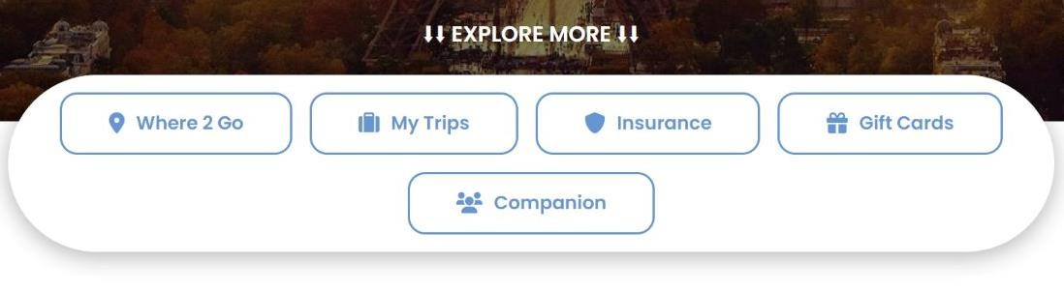

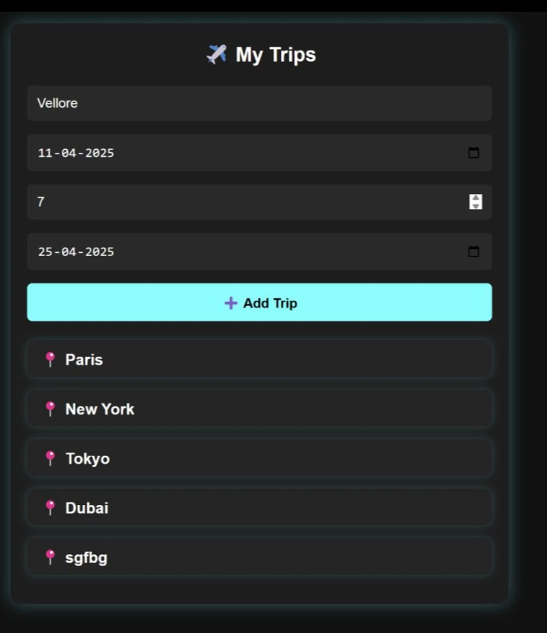
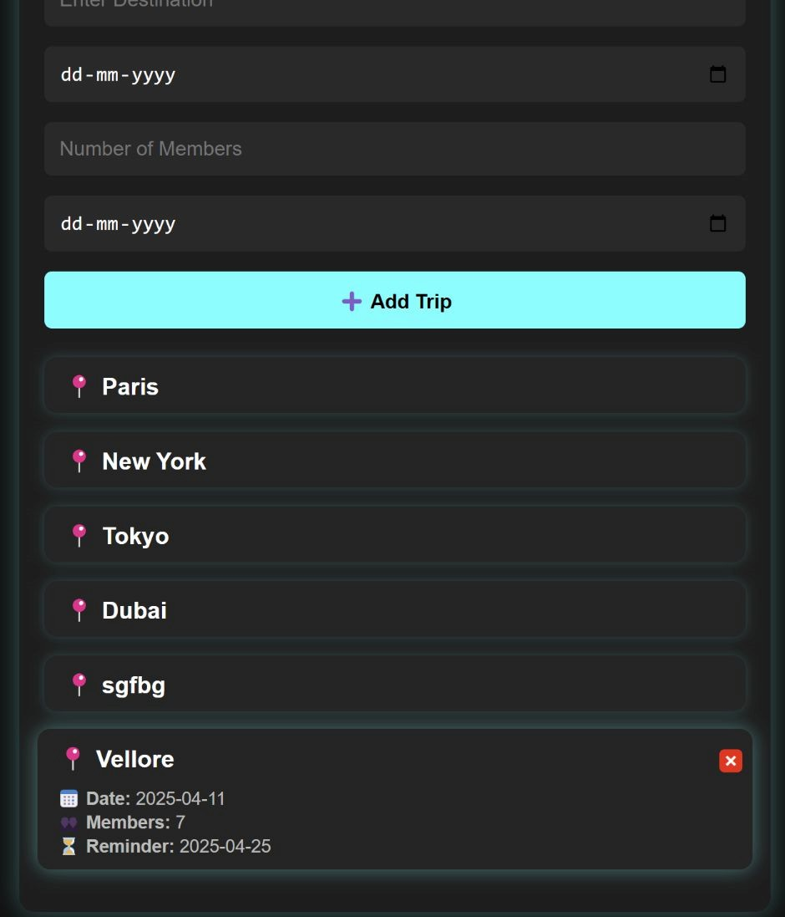
My trips webpage

Slide 8
HTML AND CSS
header section - contains the logo, slogan, profile button, and language selection
input fields - allow users to enter trip details like destination, date, members, and reminder
button for adding trips - triggers the javascript function to store trip data
trip list container - dynamically displays saved trips with delete options
script tag - embeds javascript to handle trip storage and interactions
styling layout - uses css to make the page visually appealing and organized
responsive design - ensures the page adapts to different screen sizes
header styling - formats the logo, slogan, and navigation elements
input field design - improves usability with consistent spacing and borders
button styling - enhances visibility and provides hover effects
trip list styling - arranges saved trips in a readable and structured format
delete button styling - highlights the remove option clearly
font and color scheme - improves readability and maintains a modern aesthetic

Slide 9
JAVASCRIPT
preloading default trips - preloadTrips()
loads default trips into localStorage if no data exists
2. adding a new trip - addTrip()
collects input values (destination, date, members, reminder)
validates inputs and stores the trip in localStorage
clears input fields and updates the trip list
3. loading stored trips - loadTrips()
retrieves trips from localStorage and displays them dynamically
shows trip details (destination, date, members, reminder)
adds a delete button for each trip
4. deleting a trip - deleteTrip(index)
asks for confirmation before deleting a trip
removes the selected trip from localStorage and updates the display
5. checking reminders - checkReminders()
ensures trip reminders are displayed or handled when the page loads

Slide 10
The use of local storage
Local storage is used in this code to save and retrieve trip details persistently on the user's browser, ensuring that data remains available even after a page refresh or closure. When a user adds a trip, the details (destination, date, members, and reminder) are stored as a JSON string in local storage, allowing them to be retrieved later.
The loadTrips() function reads this stored data, converts it back into a JavaScript array, and displays it dynamically. A preloadTrips() function also initializes default trips for first-time users, ensuring a smooth experience.
Users can also delete trips, which updates the local storage accordingly. This approach enhances user experience by keeping data accessible without requiring a server or database.

Slide 11
Insurance webpage

Slide 12
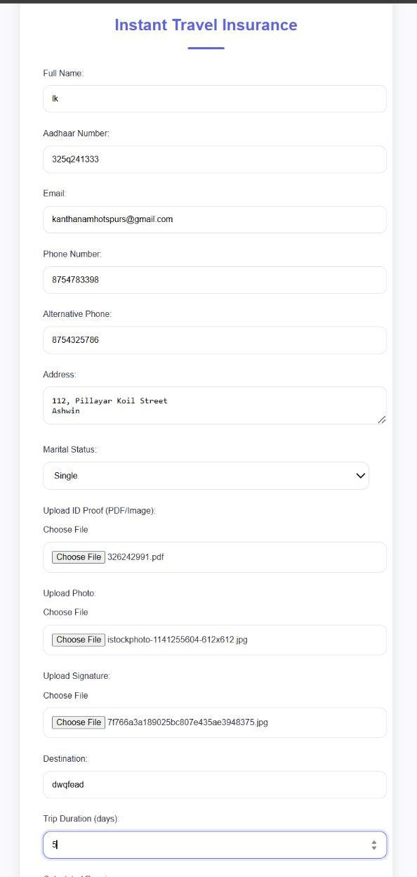
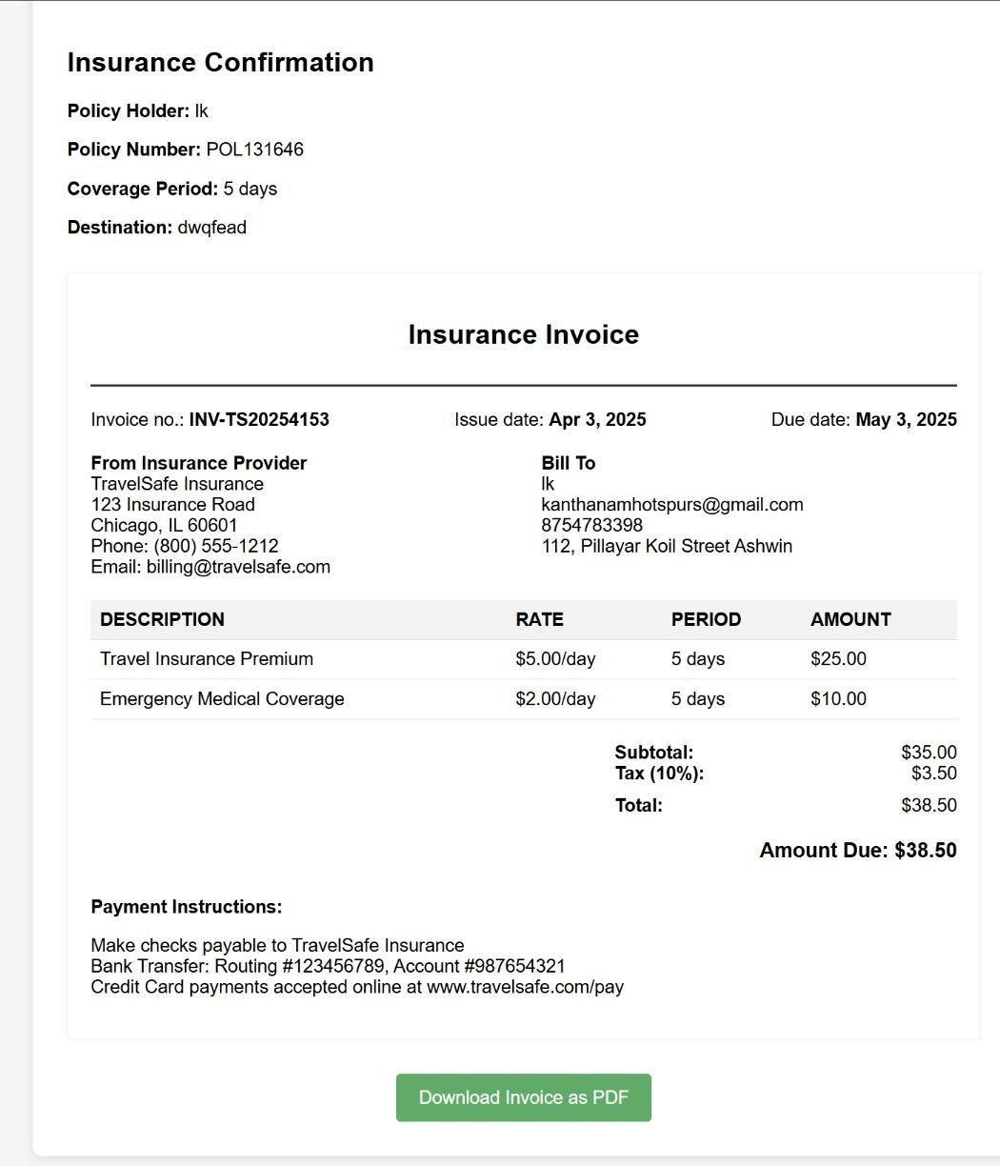



Slide 13
HTML and CSS
Custom File Upload UI – Styled file input for a cleaner and more user-friendly experience.
Premium Calculation (Auto-Update) – Prevents manual errors and enhances convenience.
Dynamic Policy & Group Number – Generates unique numbers for a realistic feel.
Left-Aligned Terms Checkbox – Improves readability while maintaining a clean layout.
Modern UI with Custom Colors – A consistent color palette creates a professional look.
Card-Based Form Styling – Shadow and border-radius add a modern touch.
Hover & Focus Effects – Interactive elements enhance user experience.
Custom File Upload Styling – Dashed borders and smooth transitions improve aesthetics.
Responsive Design – Optimized for different screen sizes.

Slide 14
JAVASCRIPT
Premium Calculation
Listens for input changes in the trip duration field. Multiplies the number of days by ₹5 to calculate the
insurance premium.
Displays the calculated premium in a readonly input field.
2) Form Submission Handling
Listens for the "Get Insurance" button click. Validates required form fields.
If validation fails, an alert prompts the user to fill in missing details.
3) Storing Form Data
Collects user details such as name, Aadhaar number, contact details, destination, and duration.
Generates a random policy number and group number for the insurance.
Saves this data in sessionStorage for use on another page.

Slide 15
4) Processing File Uploads
Reads and stores uploaded files (ID Proof, Photo, and Signature) as Base64 data in sessionStorage
using FileReader().
5) Redirection to Confirmation Page
Once the form data and files are stored, the script redirects the user to confirmation.html for further processing or display.

Slide 16
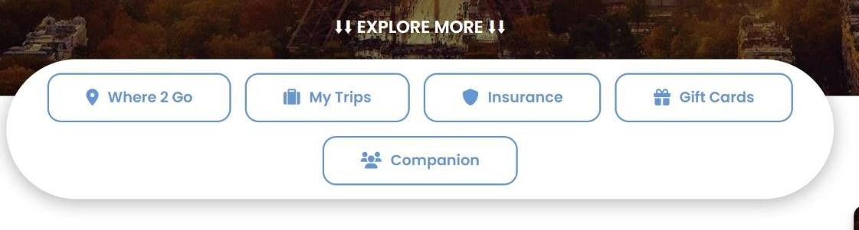

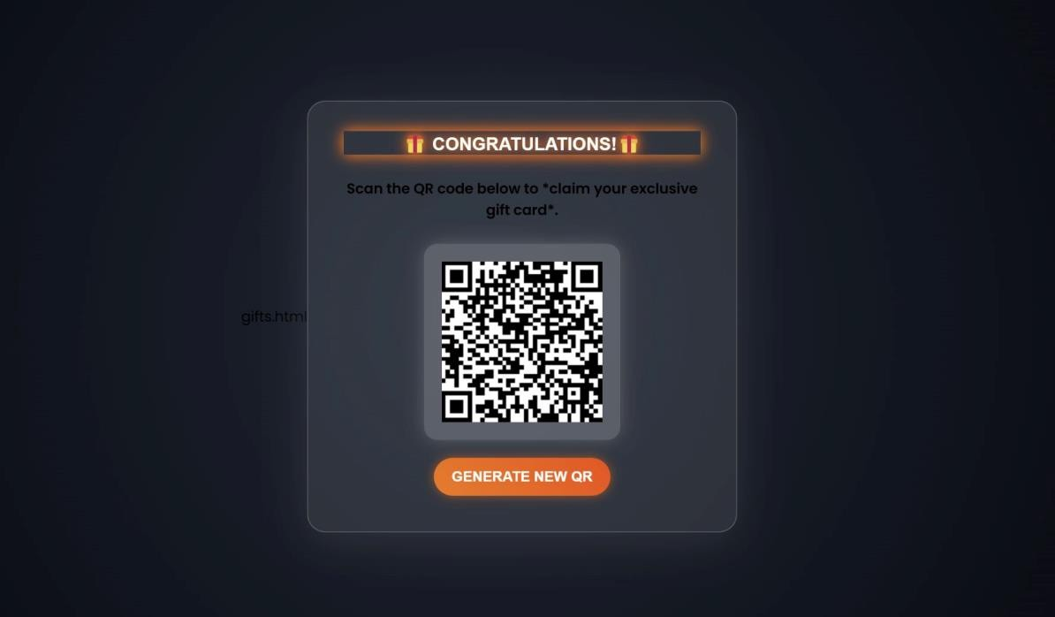
GIFT CARD WEBPAGE

Slide 17
HTML AND CSS
Global Styles
* { margin: 0; padding: 0; box-sizing: border-box; font-family: 'Poppins', sans-serif; } ensures consistency.
transition: all 0.3s ease; enables smooth animations.
Header Styling
position: fixed keeps the header at the top.
Typography and Effects
.slogan { text-transform: uppercase; letter-spacing: 1px; font-family: 'Merriweather', serif; } gives a professional look.
.logo { font-size: 24px; font-weight: 600; } makes the logo stand out.
Interactive Buttons
.btn-login:hover { background: white; color: black; } adds hover effects.
.refresh-btn { background: linear-gradient(45deg, #ff7300, #ff4500); animation: pulse 1.5s infinite alternate; } gives a glowing effect.

Slide 18
QR Code Styling
.qr-container { background: rgba(255, 255, 255, 0.2); padding: 20px; border-radius: 15px; }
creates a glass effect.
.qr-container:hover { transform: scale(1.1); box-shadow: 0px 0px 30px rgba(255, 255, 255, 0.3); } enhances hover interaction.
Animations
@keyframes glow creates a pulsing glow effect.
@keyframes floating moves background particles for a dynamic feel. JAVASCRIPT
generateQRCode()
Clears any previously generated QR code.
Generates a unique link by appending a random string to a base URL.
Creates a new QR code with the generated link using the QRCode library.
Displays the QR code in the qrcode div. 2)window.onload = generateQRCode
Calls the generateQRCode function automatically when the page loads to ensure a QR code
is displayed immediately.

Slide 19
3)We are also importing the Qr code generator from a different website
(https://cdnjs.cloudflare.com/)

Slide 20

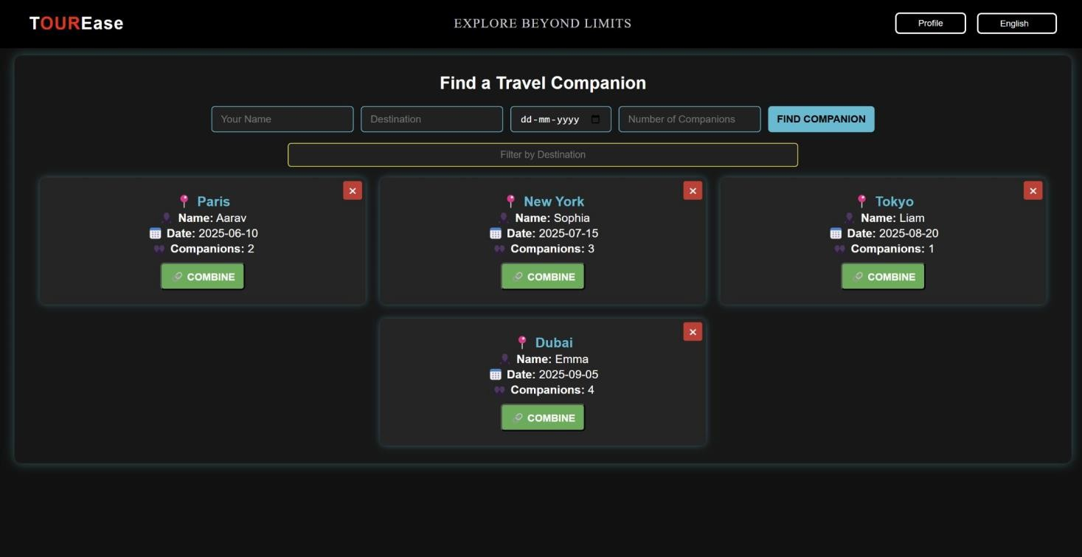
Travel companion webpage

Slide 21
JAVASCRIPT
DOMContentLoaded Event
document.addEventListener("DOMContentLoaded", () => { preloadCompanions(); loadCompanions(); });Executes
when the HTML document is fully loaded.
2)preloadCompanions()
Checks if the companions list exists in localStorage. If not, it initializes with default companion data.
3) addCompanion()
Collects user input values. Validates that all fields are filled. Stores the companion data in localStorage. Calls loadCompanions() to refresh the list. Clears input fields after submission.
4) loadCompanions()
Retrieves the list of companions from localStorage. Creates HTML elements dynamically to display each
companion.
Adds a Combine (combineCompanion()) and Delete (deleteCompanion()) button for each companion.
5) deleteCompanion(index)
Prompts the user to confirm the deletion.
Removes the selected companion from the companions list. Updates localStorage and refreshes the display.

Slide 22
6) filterCompanions()
Retrieves the filter input value. Filters the list of companions based on the destination. Updates the displayed list dynamically.
7) combineCompanion(name, destination, date)
Displays an alert confirming that the user is matched with a companion for a trip.
HTML AND CSS
Global Reset: Removes default spacing.
Dark Theme: Black background, white text.
Fixed Header: Stays on top with flexbox layout.
Interactive Buttons: Hover effects & smooth transitions.
Companion Cards: Styled with shadow & neon glow.
Filter Input: Highlights when focused.
Action Buttons: Combine & Delete with hover effects.

Slide 23

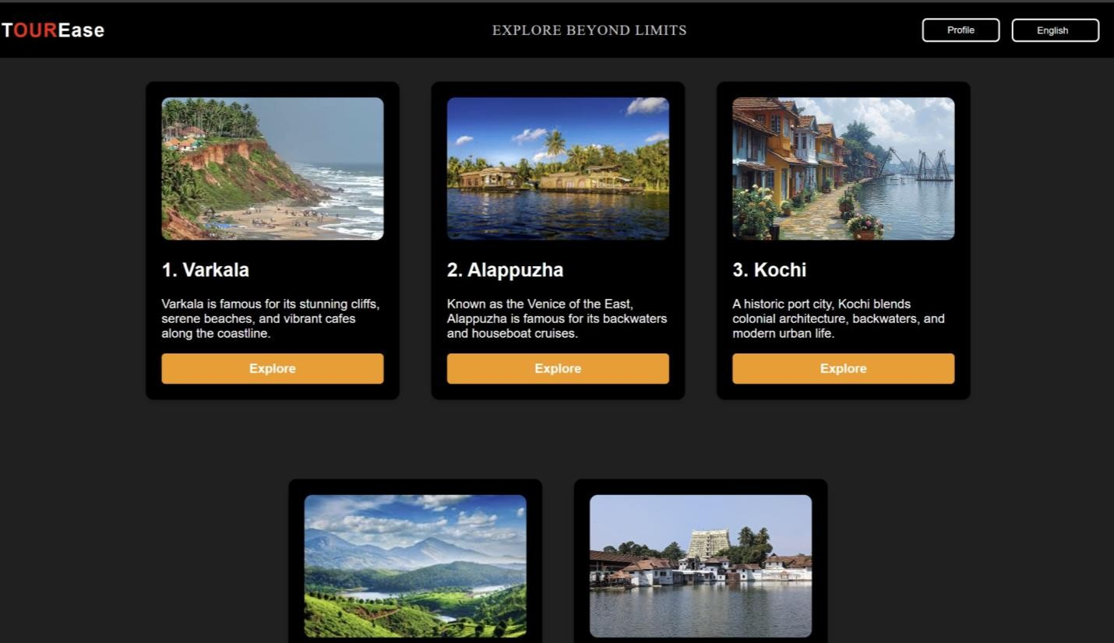
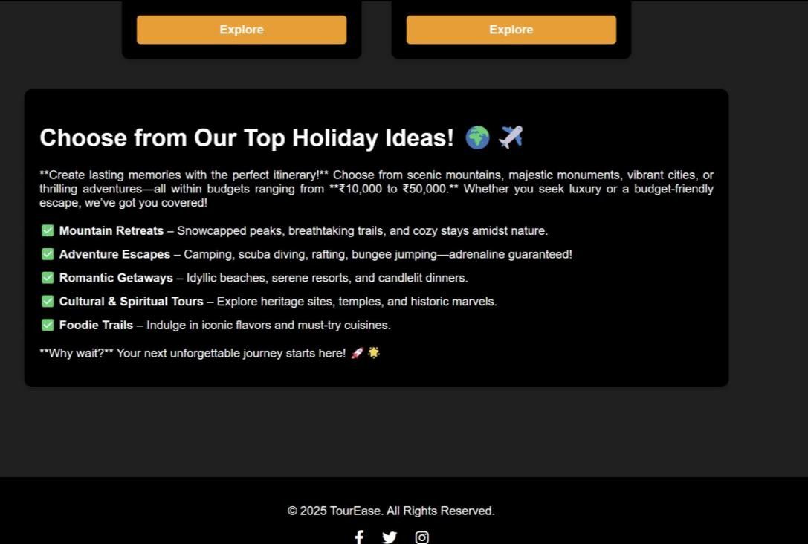
WHERE 2 GO PAGE

Slide 24
HTML AND CSS
Highlighted Logo for Brand Identity
Uses T<span class="highlight">OUR</span>Ease to emphasize "OUR" in red.
Modern and clean typography (font-size: 24px; letter-spacing: 1px;).
2) Interactive Navigation Bar
Profile button with hover animation (.btn-login:hover { background: white; color: black; }).
Dropdown menu changes appearance when hovered (background: white; color: black;).
3) Destination Cards with Hover Effect
Smooth zoom effect (transform: scale(1.05);).
Consistent card styling (border-radius: 10px; background: black; color: white;).
4) Eye-Catching Explore Button
Uses bright orange (background: #ff9800;).
Hover effect (background: #e68900;).
Clear call-to-action with bold text.

Slide 25

5) Engaging Holiday Ideas Section
Dark background with soft contrast (background: black; color: white;).
Well-structured text alignment (text-align: justify;).
Icons ( ) for better readability in <ul>.

Slide 26
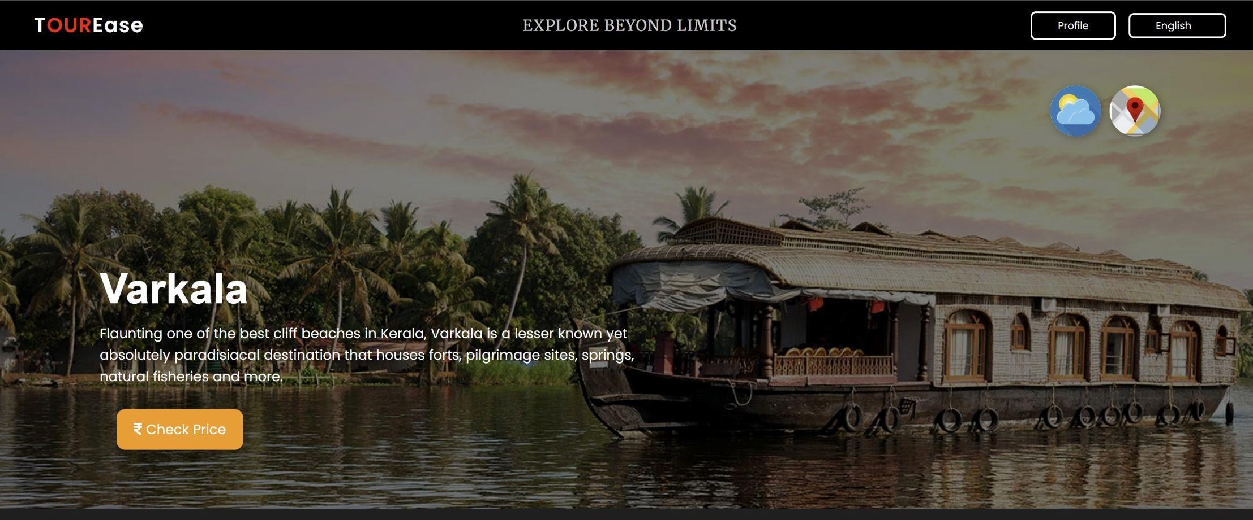


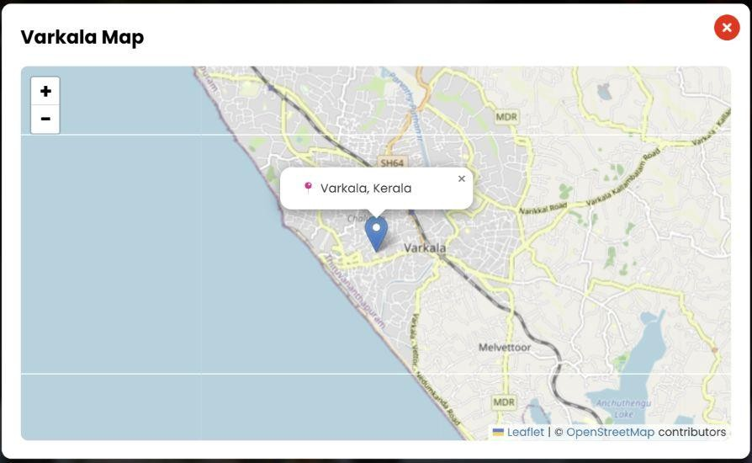
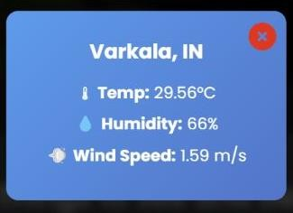
DESTINATION PAGE(VARKALA)

Slide 27
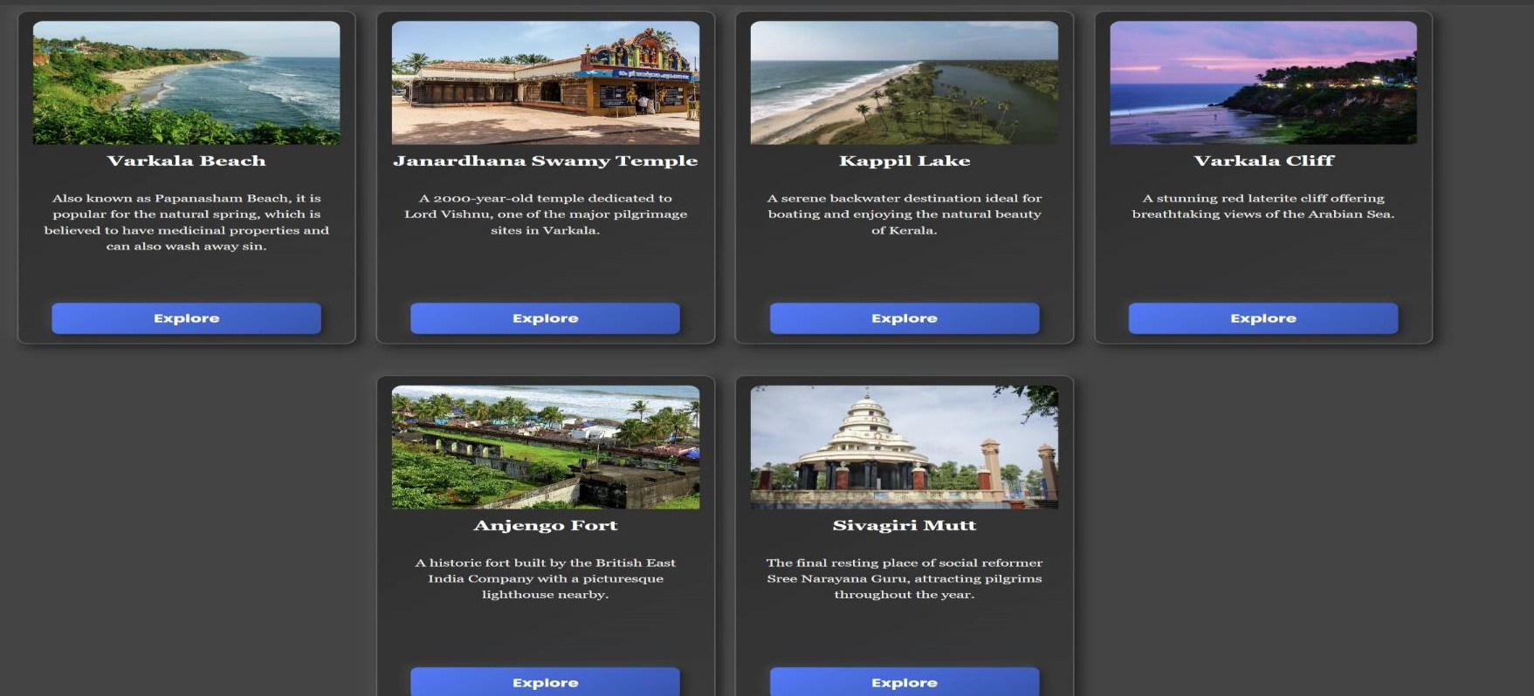
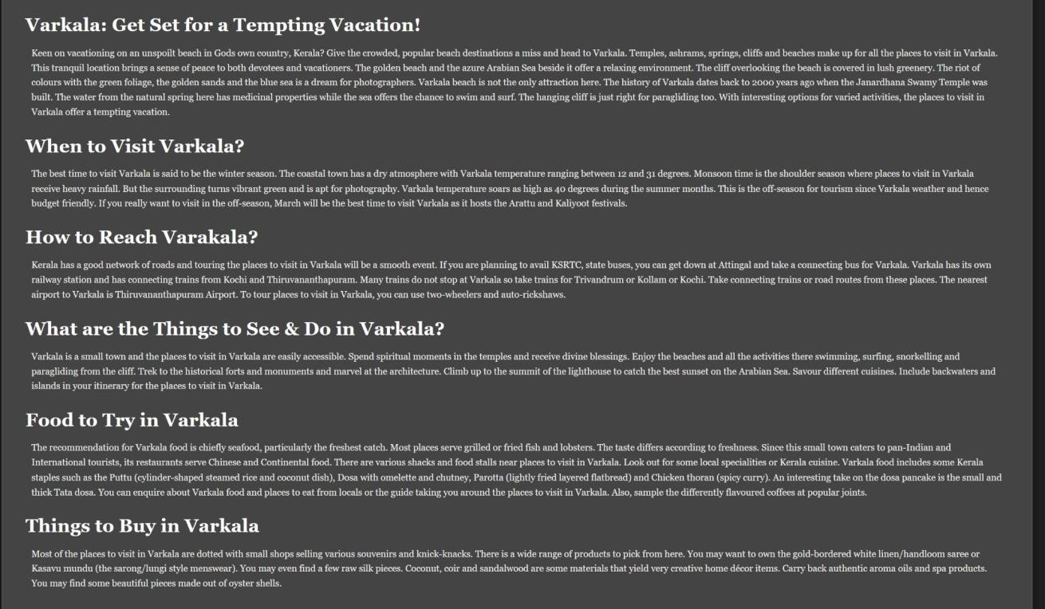

Slide 28
HTML AND CSS
Smooth User Experience with Transitions
Enhances the overall feel by making hover effects, color changes, and size adjustments appear fluid rather than abrupt.
Stylish Login Button
Bordered Design: border: 2px solid white; makes it stand out.
Hover Effect: background: white; color: black; inverts colors for a dynamic interactive effect.
Rounded Corners: border-radius: 6px; gives a modern touch.
3. Background Image with Overlay
Full-Width Background: Enhances visual appeal.
Dark Semi-Transparent Overlay: background: rgba(0, 0, 0, 0.5); ensures readability while maintaining aesthetics.
Interactive Circular Buttons (Weather & Map)
Circular Shape: border-radius: 50% makes them visually appealing.
Hover Effect: transform: scale(1.1); adds an engaging animation.
Box-Shadow: box-shadow: 2px 2px 10px rgba(0, 0, 0, 0.3); gives a 3D effect.

Slide 29
Content Cards with Premium Design
Dark Gradient Background: background: linear-gradient(145deg, #2c2c2c, #3a3a3a); gives a
futuristic, premium look.
3D Box-Shadow Effect: box-shadow: 5px 5px 15px rgba(0, 0, 0, 0.6); makes it stand out from the background.
Rounded Corners & Border: border-radius: 12px; ensures a smooth, elegant appearance.
Elegant Explore Button Inside Cards
Gradient Blue Background: background: linear-gradient(145deg, #007bff, #0056b3); gives a modern, high-end look.
Hover Effects: scale(1.05), box-shadow changes add depth.
Click Effect: scale(0.98); gives a realistic press feel.
Pop-Up Effects (Weather & Map)
Blurred Background: backdrop-filter: blur(8px); adds an elegant glass effect.
Centered Popup Animation: @keyframes fadeIn; enhances the UX.
Red Close Button:color: red; transition: 0.3s; ensures easy visibility.

Slide 30

JAVASCRIPT AND REACT
React-Based Interactive Popups
Map Popup (Displaying Varkala Map): MapPopup() React Component
Opens a modal with an embedded Leaflet.js interactive map.
Uses Varkala’s coordinates ([8.7333, 76.7167]). Displays a marker ( Varkala, Kerala) and popup with location details. Uses useState() to toggle visibility.
Adds/removes event listeners dynamically
Weather Popup (Fetching Live Weather Data) :WeatherPopup() React Component
Fetches real-time weather data for Varkala from OpenWeather API.
Uses useState() to store weather data and popup state. Displays temperature, humidity, and wind speed. Uses fetch() to make an API request.

Slide 31
Event Listeners for Buttons
Elements Responsible:document.querySelector()
Functionality:
Listens for clicks on Map and Weather buttons.
Calls the respective popup functions (openMap(), fetchWeather()).
ReactDOM Rendering for Components
Element Responsible:ReactDOM.createRoot()
Functionality:
Renders the WeatherPopup and MapPopup components inside <div id="root">.
Ensures components are loaded dynamically.

